Slide 1



A NEURAL NEWORK FROM SCRATCH USING QuTIP
Sean Kennedy, SMU

Slide 2
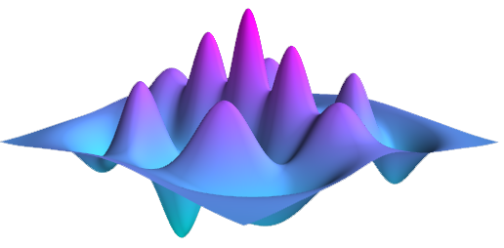
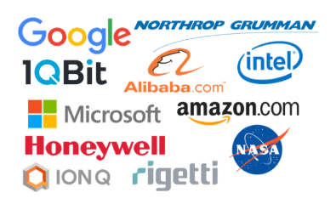
Qutip: Quantum toolbox in python
From the classroom to the corporate office, QuTiP is used around the world to advance research in quantum optics. QuTiP is in use at nearly every single research university around the globe, government-funded research labs, and is relied upon by every major corporation focused on developing a quantum computer.

Slide 3
What is Qutip?
“QuTiP is open-source software for simulating the dynamics of closed and open quantum systems. The QuTiP library uses the excellent Numpy, Scipy, and Cython packages as numerical backend, and graphical output is provided by Matplotlib. QuTiP aims to provide user-friendly and efficient numerical simulations of a wide variety of quantum mechanical problems, including those with Hamiltonians and/or collapse operators with arbitrary time-dependence, commonly found in a wide range of physics applications. QuTiP is freely available for use and/or modification, and it can be used on all Unix-based platforms and on Windows. Being free of any licensing fees, QuTiP is ideal for exploring quantum mechanics in research as well as in the classroom.” (https://github.com/qutip/qutip/blob/master/README.md)
Notes:
Part of the NUMFOCUS project (scipy, numpy, sympy) – QuTiP is an open source library used throughout academia and enterprise and is designed specifically for the purpose of developing a quantum computer.
Native latex support makes it ideal for scientific literature and it’s interface is immediately intuitive to anyone familiar with the matrix formulation of QM.

Slide 4
WhY do SMART PEOPLE physicists like it?
Two Words – Bra-Ket Notation (perhaps there’s more to it than that, but this is a good place to start).
LaTex – not the freaky kind (which is fun) , the text kind – which is beautiful in its own right.
Plotting – Who wants to make all those nasty 3-d plots that optics is famous for? Let an API do that for you. Stand on the shoulders of giants (especially when it comes to matplotlib which serves as the main plotting engine).
Tensors* – Get crazy and rebuild tensorflow from scratch? We’ll do just that in this analysis (well, perhaps a reasonable facsimile given the time constraint, but neural nets are all black box anyway – as long is works – amirite????). Google, watch your back.
* No real tensors will be used in this process, that would be crazy – BUT – we could if we wanted to….

Slide 5
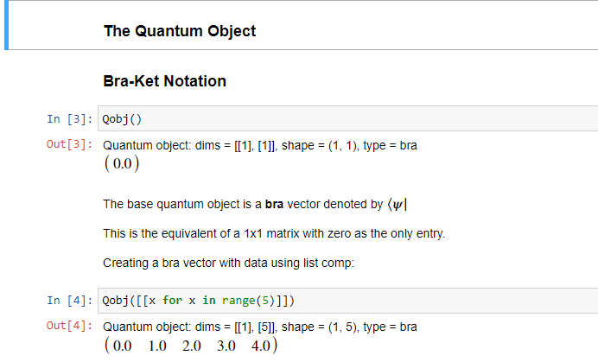
BRA-KET Notation: Why aren’t you using this?
Introduced by physics legend Paul Dirac, bra-ket notation is method for expressing linear algebra concepts concisely – independent of the number of basis vectors chosen to represent the underlying system.
Of interest, is the ease with which bra-ket notation makes the mathematical concept of the inner/dot product between two vectors simple to represent.
In the QuTiP nomenclature, all objects inherit from the base QuantumObject (Qobj)
This object is a “bra” or, more concisely, a row vector
Notes:
Think of a Bra as a row vector
Inner product – defines the inner product space
The inner product provides the definition of distance
Also defines the concept of angle

Slide 6
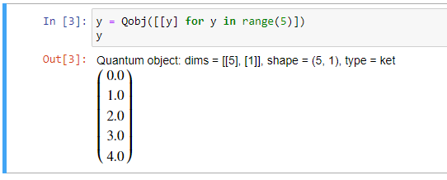
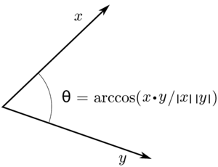
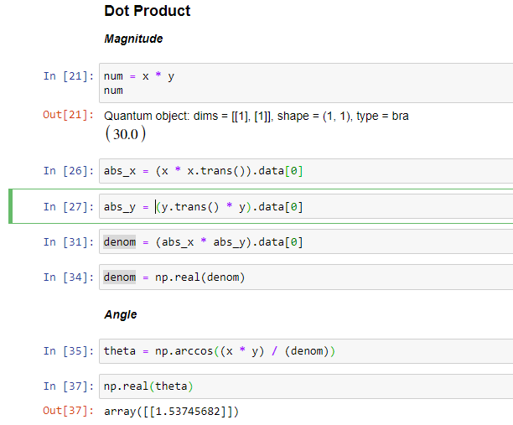

Kets and the inner product
This object is a “ket” or, more concisely, a column vector
Note the extra brackets around our initialization variable, y. This instructs the QuTip API to create a column vector rather than a row vector.
A vector space is considered an inner product space if there exists a function that defines both the distance and orientation between two different vectors in the space.
In 2-d space, the inner product can be represented in terms of the lengths of vectors x and y and the cosine of the angle between them.
THIS IS THE IDEA BEHIND COSINE SIMILARITY
Notes:
Think of a Ket as a column vector
Inner product – defines the inner product space
The inner product provides the definition of distance
Also defines the concept of angle

Slide 7
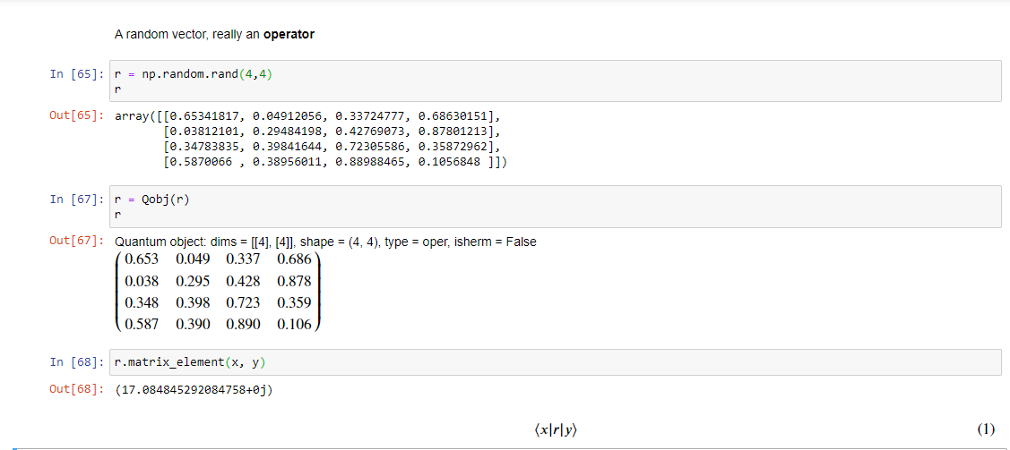
Operators: linear algebra’s function
Operators are (nxm) matrices that can operate on vectors (or other operators) – provided their dimensions match.
The example below creates a random operator – a 4 x 4 matrix consisting of all random values.
Note that QuTiP has called this an operator – not a bra or a ket. In this notation – the operator r acts first on the ket vector, y – the result of this operation is then combined with the bra vector, x, via the dot product.
Notes:
Produces scalar value
A 4x4 matrix multiplication to a 4x1 vector results in another 4x1 vector
Dot product of a 1x4 and a 4x1 scalar

Slide 8
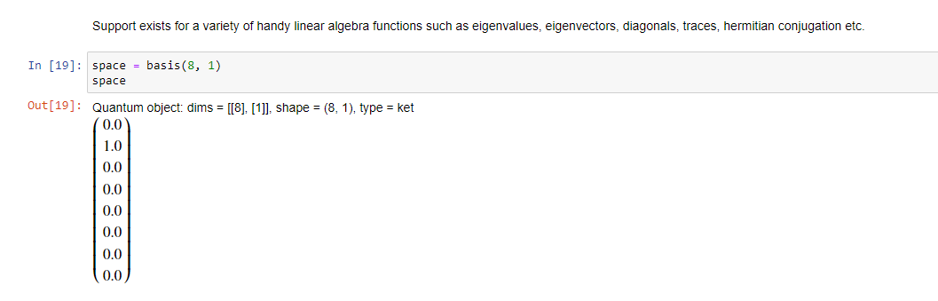
HILBERT SPACES
“The mathematical concept of a Hilbert space, named after David Hilbert, generalizes the notion of Euclidean space. It extends the methods of vector algebra and calculus from the two-dimensional Euclidean plane and three-dimensional space to spaces with any finite or infinite number of dimensions. A Hilbert space is an abstract vector space possessing the structure of an inner product that allows length and angle to be measured. Furthermore, Hilbert spaces are complete: there are enough limits in the space to allow the techniques of calculus to be used.” (https://en.wikipedia.org/wiki/Hilbert_space)
Creating a Hilbert space of arbitrary dimensions is trivial in QuTiP - in this case an 8-dimension space where the ground state energy is in the first state (n=1)
Notes:
Hilbert spaces are often infinite due to the fact that they represent probability states.

Slide 9
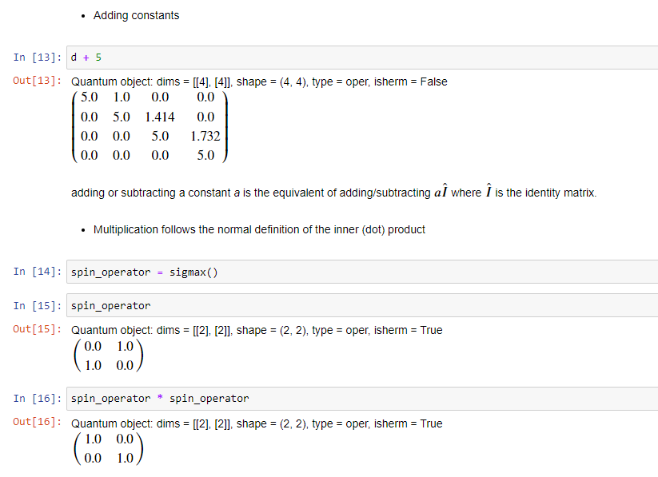
Matrix Mathematics

Slide 10
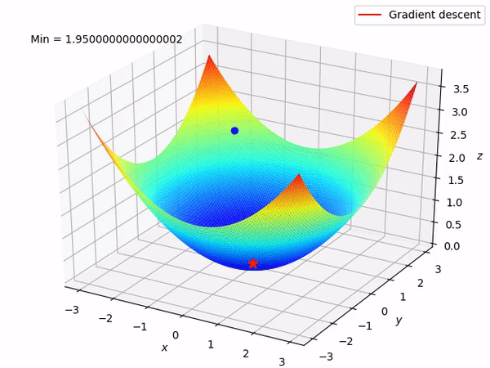
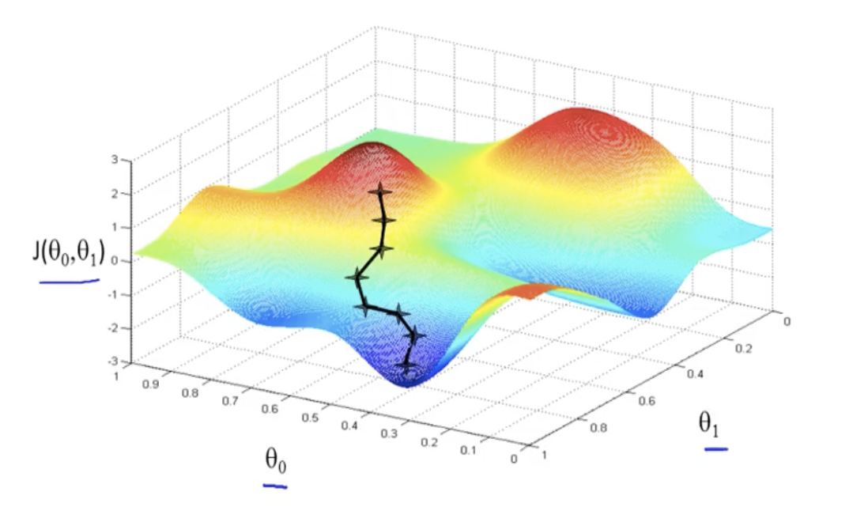
Stochastic Gradient DESCENT
Gradient descent is an optimization algorithm which seeks to determine the absolute minimum of a function.
In the case of a purely convex function, this is easy, the min (or max) is always well defined.
But most functions are not convex and cannot be analytically differentiated.
An iterative process based on constant tweaking of parameter weights can be used to solve for a local (potentially global) minimum.
Notes:
Ball rolls down hill – bla bla bla

Slide 11

LEARNING RATE
How far do we take a step in our error space when we choose to move?
Not moving far enough could confine us to a local minimum… bad.
Moving too far could have us searching around forever – never settling into any potential minimum.
Ideally, a time decayed learning rate is best. Search a wide space in the early epochs of training – narrow the search as epochs evolve.

Slide 12
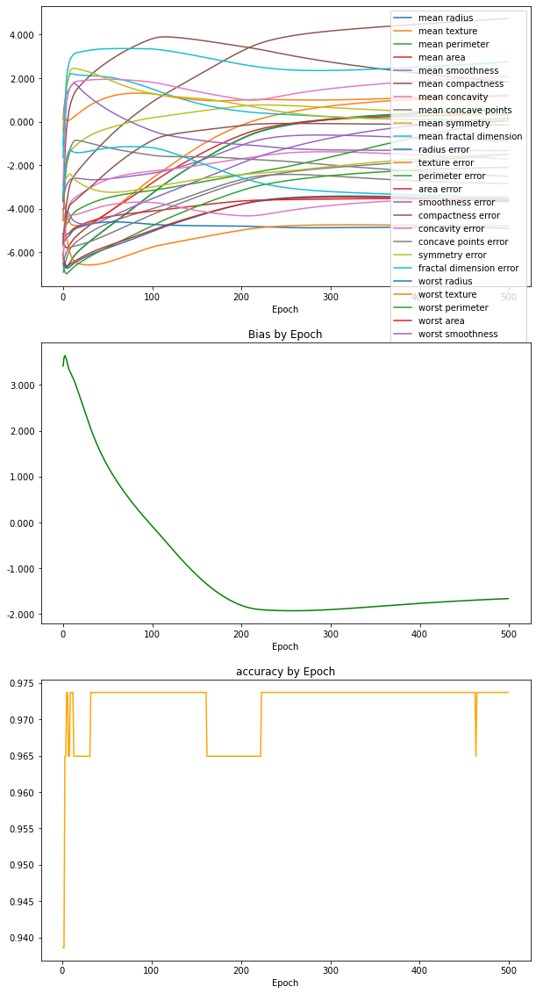
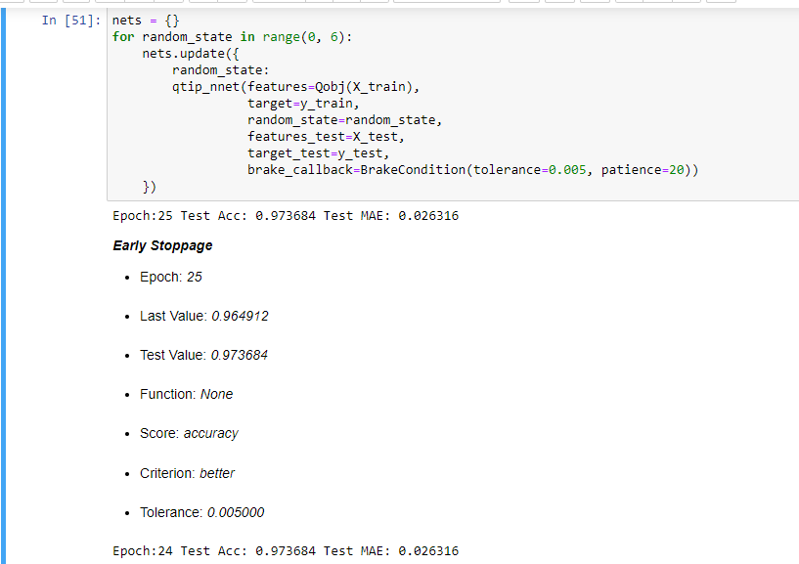
BRAKING CoNDITIONs
Iterative processes are expensive – and hopefully converge quickly.
But we can’t wait forever.
At some point, the iterative process of weight/bias tuning will reach point of diminishing returns.
At this point – training should end – braking conditions ensure that models are trained in an efficient way.
Notes:
Notes on tolerance, patience, function choice

Slide 13
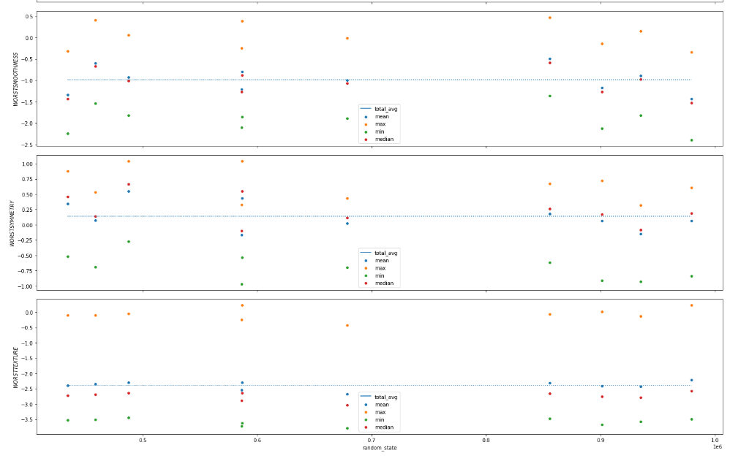
WEIGHT WATCHING
Ideally – weights should be consistent across training epochs – even when randomizations are applied.
On far more robust scale – this could be accomplished with a library like WeightWatcher – a library that monitors the statistical properties of neural nets while training.
q-tip-perceptron implements a basic framework for monitoring weights in a similar manner by examining the statistical properties of weights as a function of the random initialization.

Slide 14
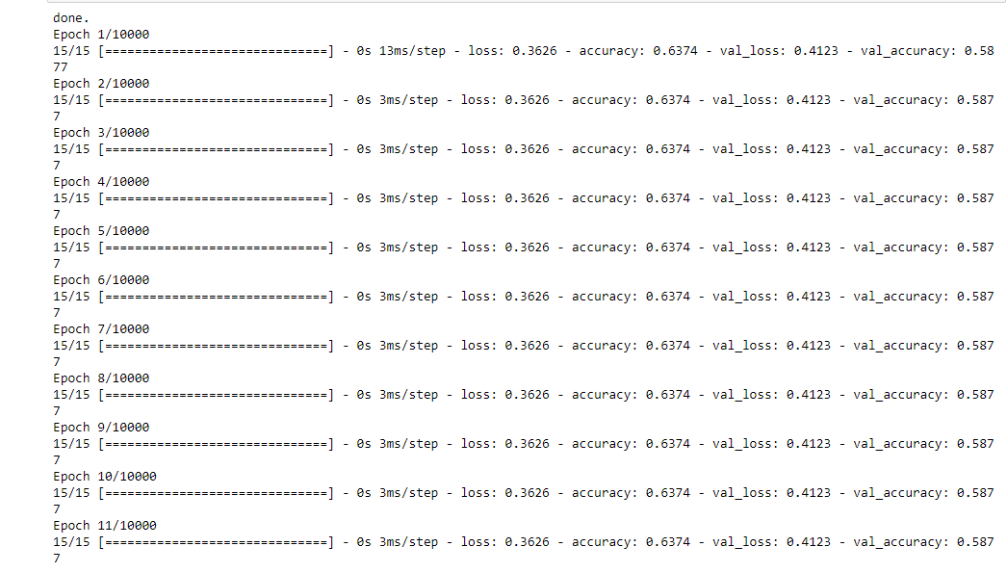


BENCHMARKNG
How does q-tip-perceptron perform against some of the most popular neural nets and traditional classifiers?
Running a simple classification on the sklearn breast cancer dataset.
Sequential Model (tensorflow)
LogisticRegression (sklearn)
RandomForest (sklearn)
Notes:
RF for feature imp

Slide 15
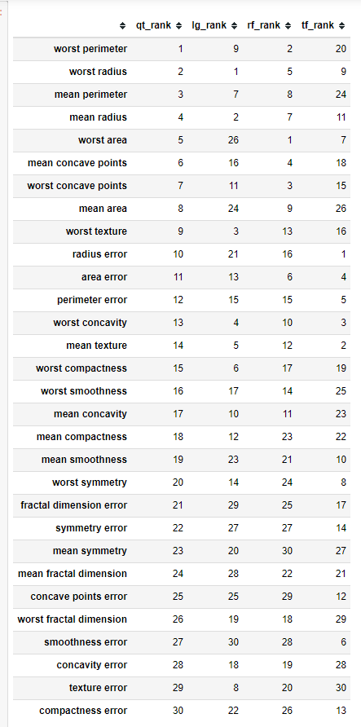
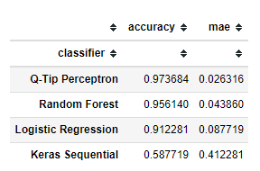
CONCLUSION
Not only was the Q-Tip Perceptron the most accurate of the 4 classifiers – it’s parameter selections where also very close to the ranks given by a Random Forest Classifier.
Sorry Keras – I clearly do not know how to tune you…. Yet ☺
Notes:
Normalization of parameters for comparison?

Slide 16

FURTHER ANALYSIS
Drop out layers – almost no opportunities for regularization exist in the current code.
Wavefunctions - as activation functions (see addendum video on theoretical construction of neural nets with time evolved weights – coming soon to a youtube near you). We didn’t talk all that physics for my benefit.
Hidden layers – current implementation is very simple – input layer → perceptron → softmax
More supporting material for this project can be found on github at:
https://github.com/fastest-parrot/q_perceptron

